Slide 1

Playing to Win: Exploring the Causal Relationship between Game Features and Positive User Feedback in the Steam Marketplace
Timothy Toth

Slide 2
What Impacts Positive Ratings for Video Games in the Steam Marketplace
The video game industry has experienced tremendous growth in recent years
Positive ratings on Steam are critical for a game's success 86% of players report paying attention to review scores(ESA)
Therefore, understanding the factors that impact positive ratings on Steam is crucial for developers seeking to improve or forecast their games' sales and success.

Slide 3
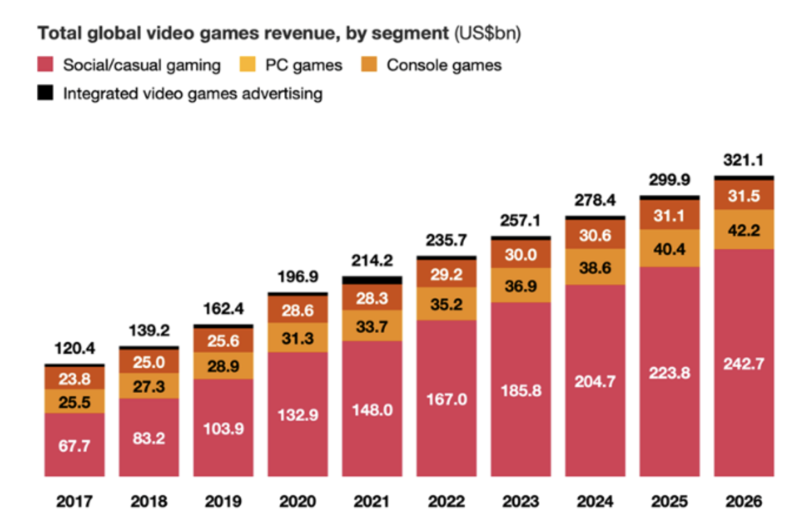

Slide 4
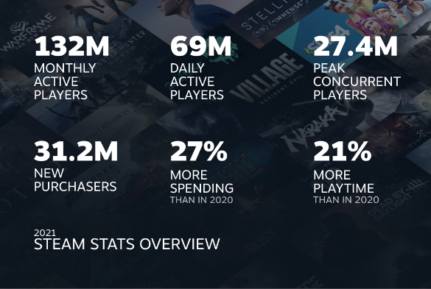
What is Steam?
Steam is the largest digital distribution platform for PC games, with over 130 million monthly active users in 2021 and thousands of games available for purchase
In 2020, the top 100 games on Steam generated $14.3 billion in revenue

Slide 5
Why should we care?
For game developers and investors,
For gamers,
Additionally, understanding the relationship between these factors and positive ratings can provide valuable insights into consumer behavior in the video game industry.

Slide 6
Previous Literature
Do online Customer Reviews Matter? Evidence from the video game industry- Feb 9,2008
Here they explore topics relating to magazines and professional critic websites
Factors that Impact Video Game Sales
This study applied a linear regression to three different countries and got statistically significant variables for different countries suggesting consumer preference per region for video games
An empirical study of early access games (EAG) on the steam platform
Throughout their study they came to the conclusion that eliciting early feedback and more positive reviews to attract additional new players.

Slide 7
Contextual Economic Theory
This is rooted in the economic theory of consumer choice, where individuals make decisions based on their preferences and budget constraints.

Slide 8
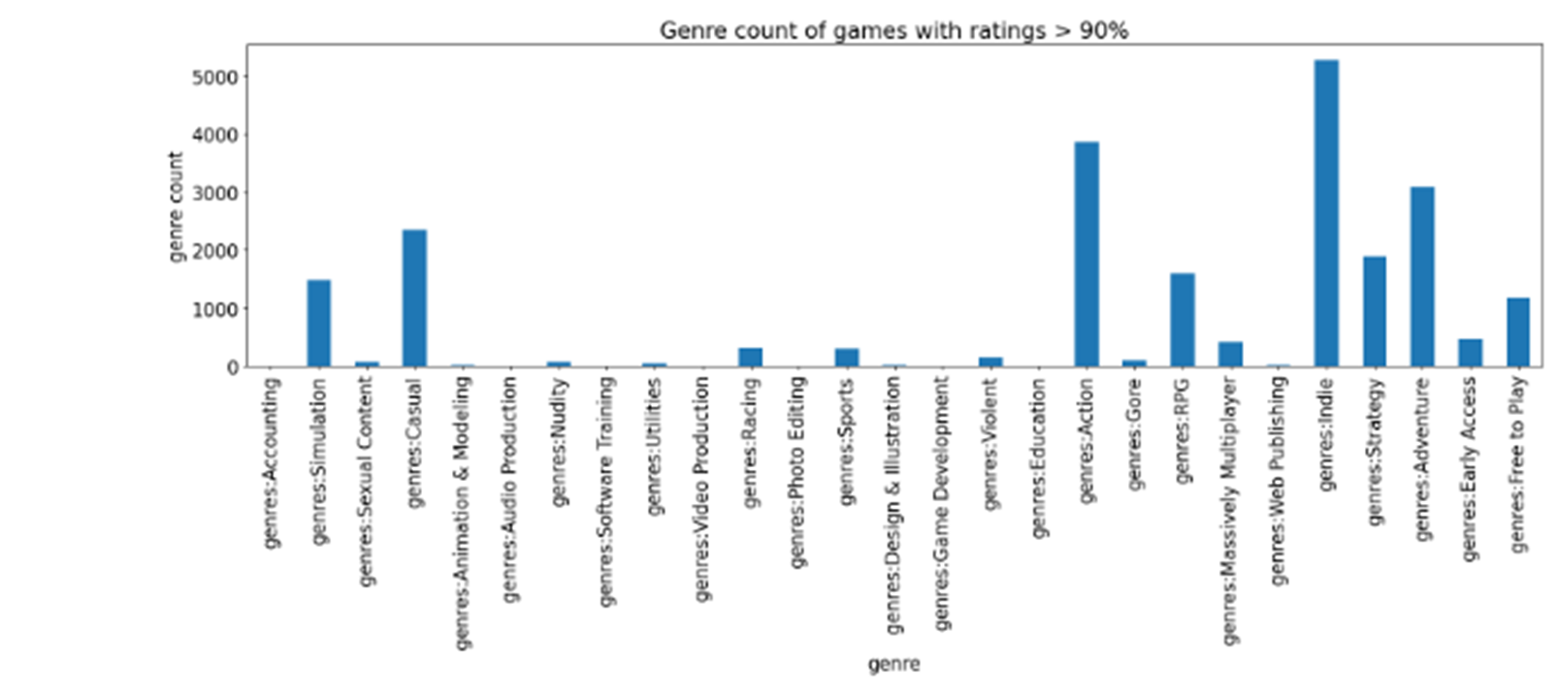
Data
Dataset is from Kaggle that was gathered around May 2019 from the Steam Store using SteamSpy Api’s.
Cleaned it to (8479,40)

Slide 9
Research Questions
Based on the statistics for a game on Steam, what features are statistically significant for impacting positive ratings?
Does Early access and Free To Play have a positive relationship with positive ratings?
Hypothesis

Slide 10
Data

Slide 11
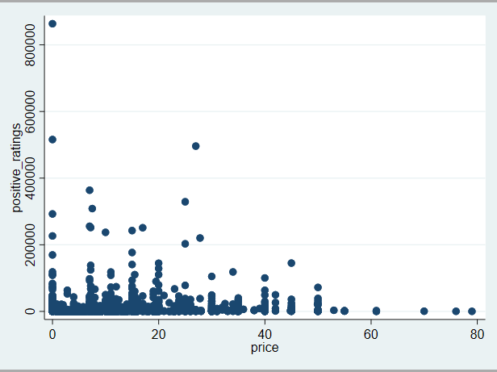
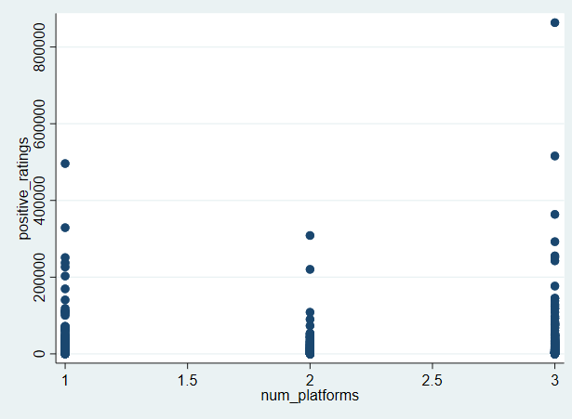
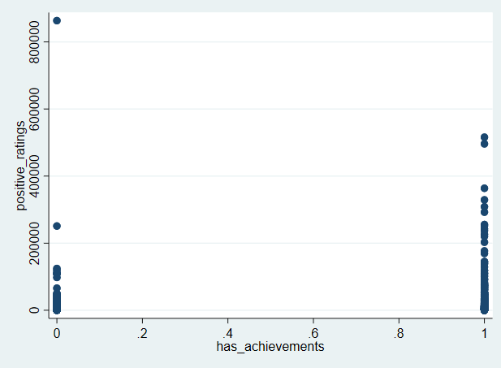

Slide 12
Empirical Strategy
pr=β0+β1has_achievements+β2rating+β3average_playtime+β4price+β5i.num_platforms+ui

Slide 13
Standard errors in parentheses
* p < 0.10, ** p < 0.05, *** p < 0.01

Slide 16
Results summarized
Achievements (+34.36 %), average playtime (+0.005%), price (+8.3%)
, and free to play games (+84.6)
Early access games were found to be associated with an (-40.7)

Slide 17
Conclusions
I find evidence that positive ratings is impacted by game features such as having achievements and average playtime
Further analysis can go into what increases a user's average playtime per game

